Slide 1
Subject | Mathematics
Grade | 2 year 1
Term | 4

Slide 2
LESSON PLAN CONTENT
Week 2 | Numbers, operations and relationships.
Week 3 | Numbers, operations and relationships.
Week 4 | Assessment week
Week 5 | Numbers operations and relationships

Slide 3
LESSON PLAN CONTENT
Week 6 | Numbers, operations and relationships
Week 7 | Assessment week
Week 8 | Space and shape - Position and views Position and directions
Week 9 | Revision

Slide 4
LESSON PLAN CONTENT
Week 10 | Assessment week

Slide 5
LESSON OBJECTIVES
To use mathematical knowledge and skills learnt in the classroom and to apply them in the real world.
To equip the learners, irrespective of their socio background, race, gender, physical ability or intellectual ability, with the knowledge, skills and values necessary for self-fulfilment and meaningful participation in the society as a citizen of the free country.
Facilitating the transition of learners from educational institution to work in the community e.g. Community Development Worker (CDW) or a sheltered workplace.
It helps the teacher to be able to: • create a leaner’s profile of competences - the profile will bridge the gap between the home and the school; • identify what the learner knows, can do and demonstrate in the teaching and learning situation.
work effectively as individuals in/or a member of a team.
Communicate effectively or by using Augmentative Alternative Communication (AAC) and other communicative devices (Sign language, Braille, etc.

Slide 6
Assessment Goals
Numbers, operations and relationships. | Identify, recognize and read number symbols 1-50. Write number symbols 1-30. Recognize and read number names 1-20.
Numbers operations and relationships | Describe compare and order numbers 1-3-. Compare whole numbers up to 10 using smaller than, greater than, more than, less than and is equal to.
Numbers, operations and relationships | - Recognize and identify the South African coins 50c, R1, R2, R5, and bank notes R10, R20, R50, R100.
Numbers, operations and relationships | Add to 18 Subtract from 18 Use appropriate symbols (+,-,=)

Slide 7
Assessment Goals
Space and shape | Position and views Understand the position of one object in relation of another e.g. top and bottom. Position and directions Follow directions to move around the classroom.

Slide 8

Numbers, operations and relationships.

Slide 9
Group 1
Color the following numbers from 1-50.

Slide 10
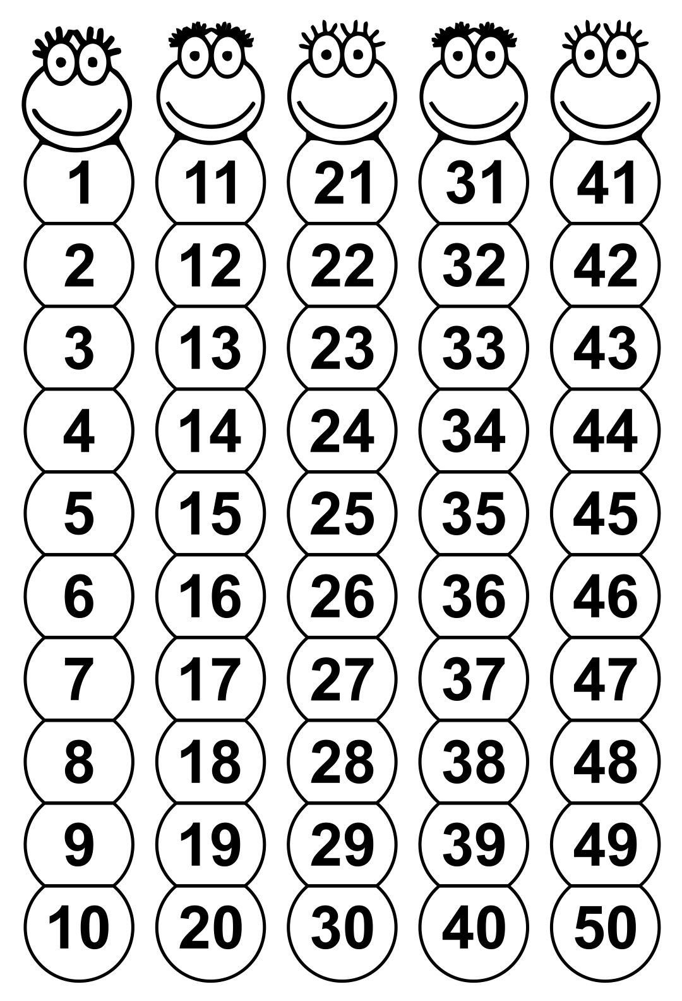

Slide 11
Group 2
Count from 1-50 using the following chart.

Slide 12
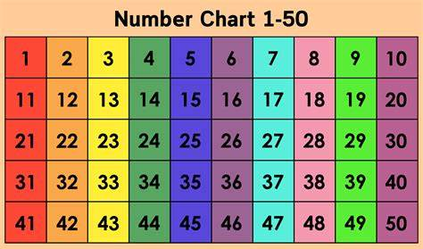

Slide 13
Group 3

Slide 14
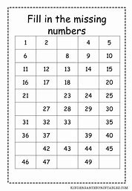

Slide 15
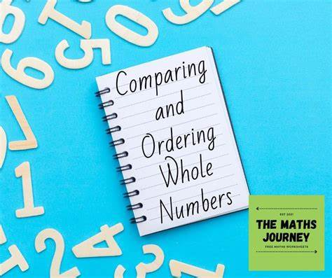
Comparing whole numbers

Slide 16
Group 1

Slide 17
Activity:
Learners will be given two groups of counters per question and they will have to choose which group has more counters than the other. For example group red has more counters than group blue.

Slide 18
Group 2

Slide 19
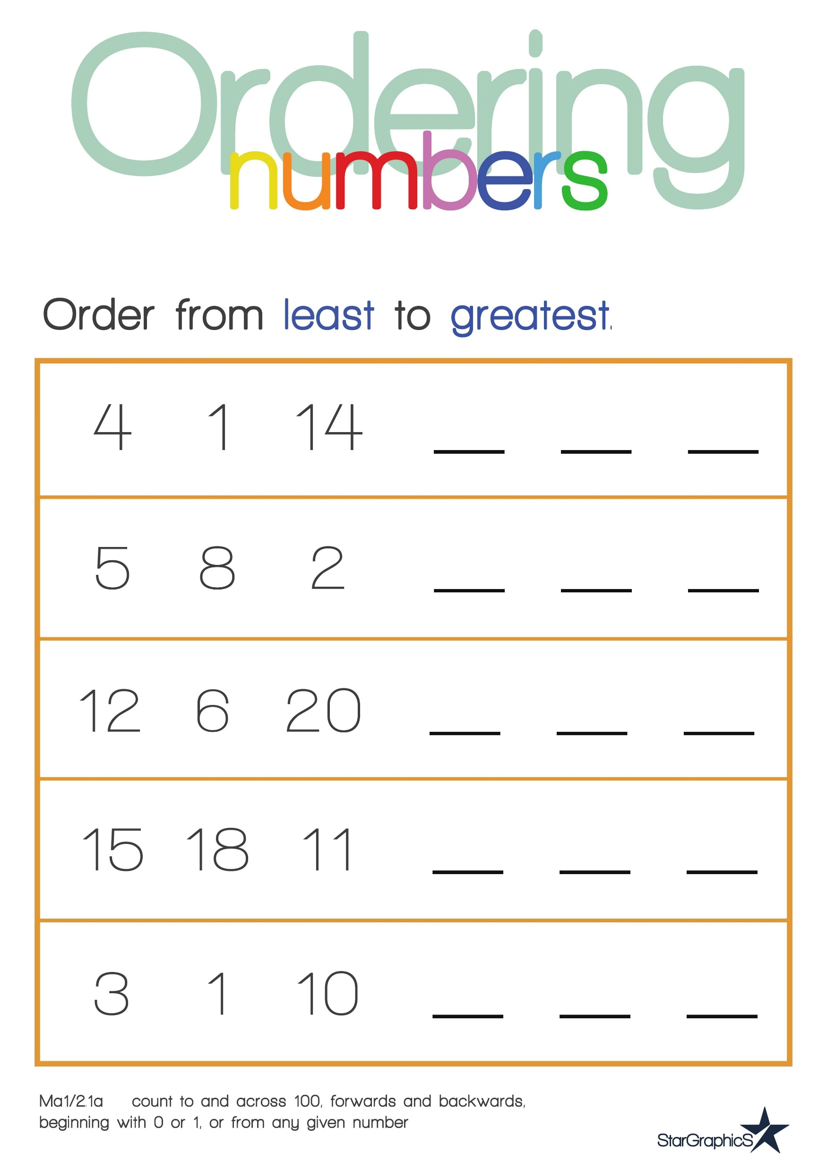

Slide 20
Group 3

Slide 21
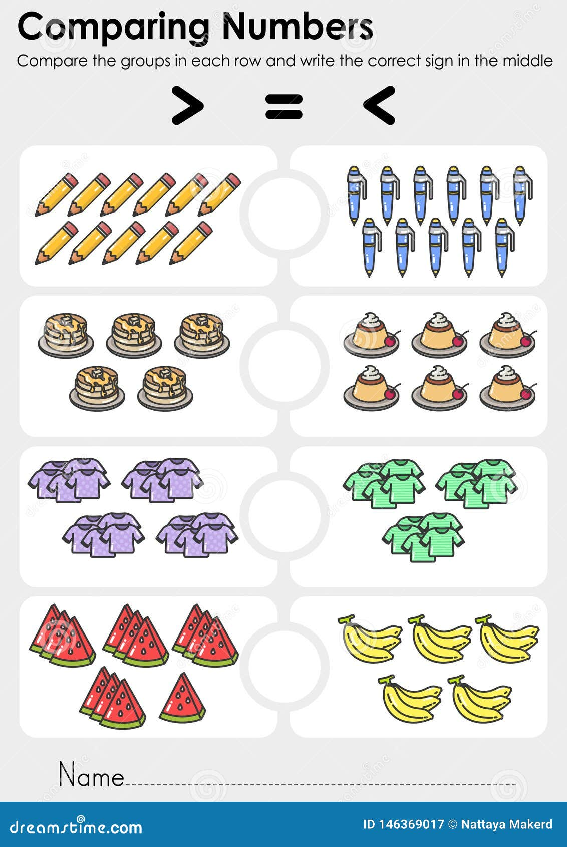

Slide 22
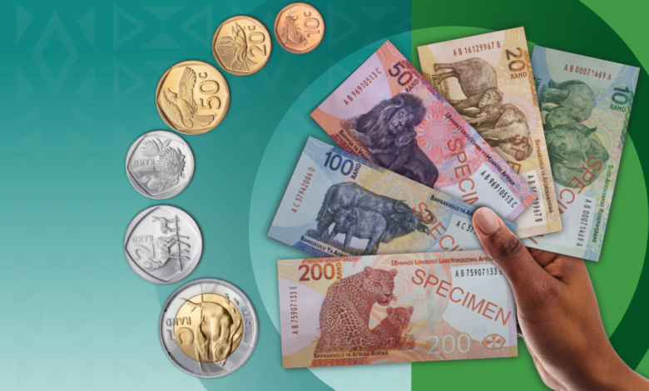
South African coins and bank notes

Slide 23
Group 1

Slide 24
Activity:
The teacher will come with the coins and bank notes in the classroom then ask learners how much money do they see.

Slide 25
Group 2

Slide 26
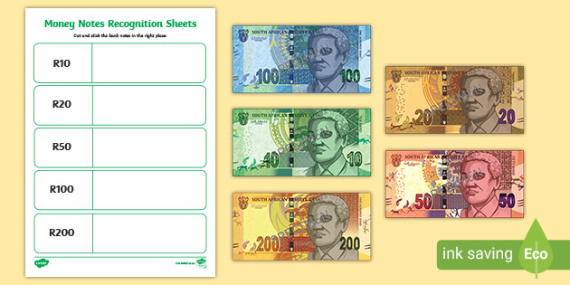

Slide 27
Group 3

Slide 28
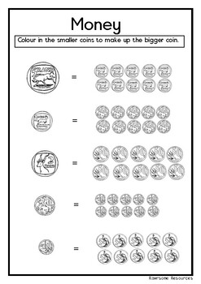

Slide 29


Slide 30
Group 1

Slide 31
Activity:
Learners will add and subtract using counters.

Slide 32
Group 2

Slide 33
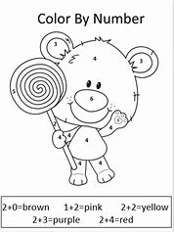

Slide 34
Group 3

Slide 35
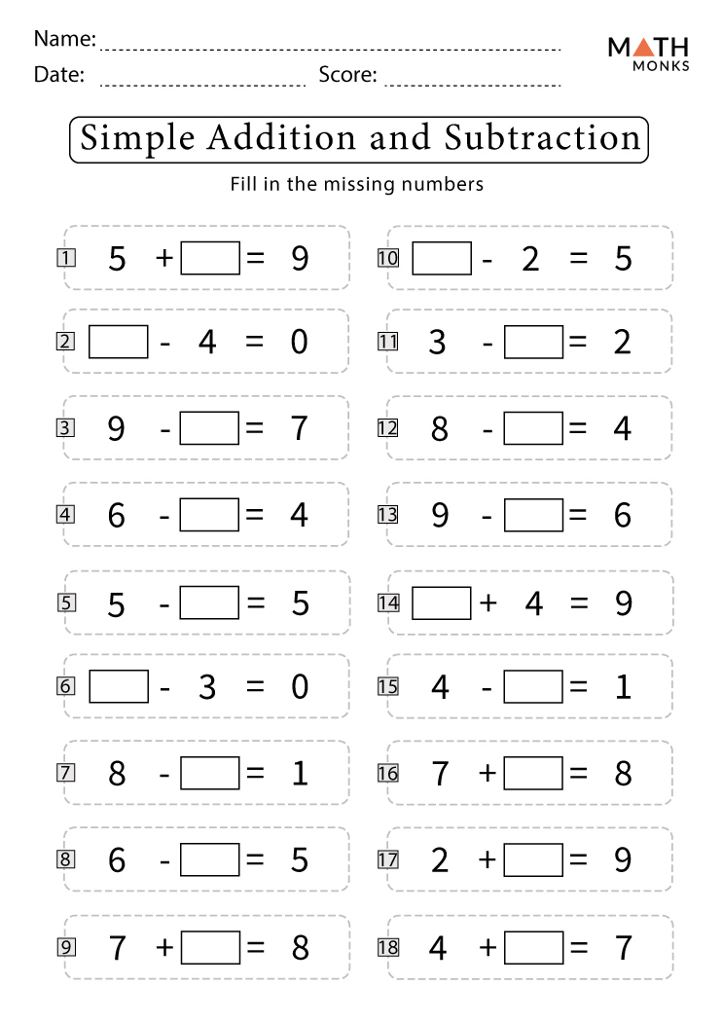

Slide 36

SPACE AND SHAPE

Slide 37
POSITIONS

Slide 38
Group 1

Slide 39
Activity:
The teacher will use objects in the classroom like chairs, desks, chalkboard, door etc. and demonstrate to learners about different positions that one object can display amongst other objects then ask learners to also demonstrate those positions.

Slide 40
Group 2

Slide 41
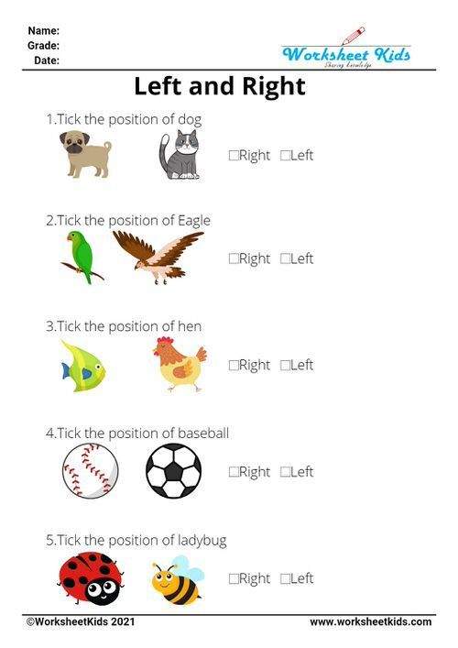

Slide 42
Group 3

Slide 43
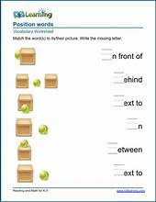

Slide 44
REFERENCES
https://themathsjourney.com/wp-content/uploads/2021/10/Comparing-and-Ordering-Whole-Numbers.jpg
https://th.bing.com/th/id/R.df29d3e121cd194ed2e635ef0c87815b?rik=hiYDwvc4JhW0yA&pid=ImgRaw&r=0
https://thumbs.dreamstime.com/z/comparing-numbers-worksheet-education-compare-groups-each-row-write-correct-sign-middle-more-equal-146369017.jpg
https://reviewonline.co.za/wp-content/uploads/sites/68/2023/05/new-money-2-e1683208962676-780x470.png
https://th.bing.com/th/id/OIP.aOT1L9IAZ7spIipoaxaqfQHaDt?rs=1&pid=ImgDetMain
https://th.bing.com/th/id/OIP.ig5GivxfxANnUbMDUJZ22wAAAA?rs=1&pid=ImgDetMain
https://th.bing.com/th/id/R.84f5822b8e3966bdf242f9bc90012f51?rik=izhv6cEw%2br3g0w&riu=http%3a%2f%2fwww.clipartbest.com%2fcliparts%2fKij%2fL7g%2fKijL7gM5T.jpg&ehk=vEIAE56wEVJGXKPU6ZpVMUjt4RgTS96PIGpPiDYJ%2bQ0%3d&risl=&pid=ImgRaw&r=0
https://th.bing.com/th/id/OIP.dktaN15vvZxBMKkC1DpElwAAAA?rs=1&pid=ImgDetMain
https://th.bing.com/th/id/OIP.d8INcl5iAndVsiHk9uMF4wHaKe?rs=1&pid=ImgDetMain
https://th.bing.com/th/id/OIP.j1fAi_jcuz_ZKQpa_extsAHaFj?w=222&h=180&c=7&r=0&o=5&pid=1.7

